Slide 1
The Hackaday Community Offline Password Keeper
Mathieu Stephan – 19/02/2014

Slide 2
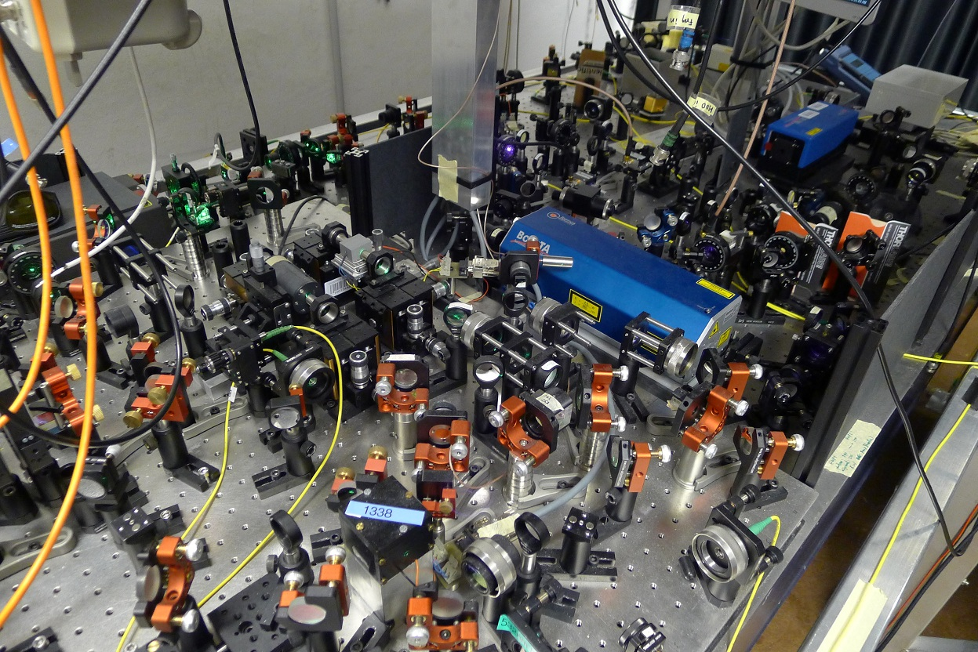
Who am I?
High Speed Electronics Engineer

Slide 3
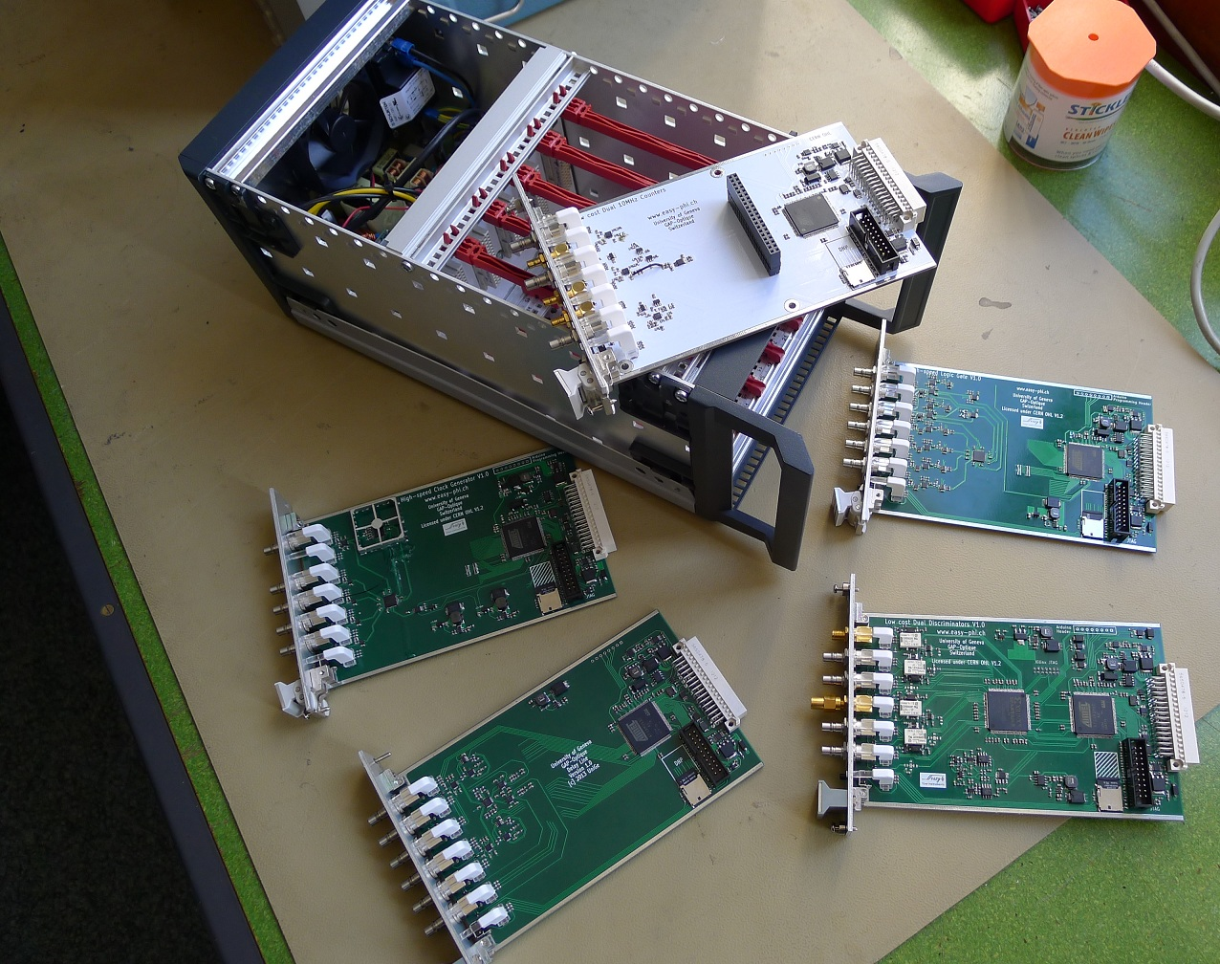
Who am I?
Working on an open platform for quantum physicists

Slide 4
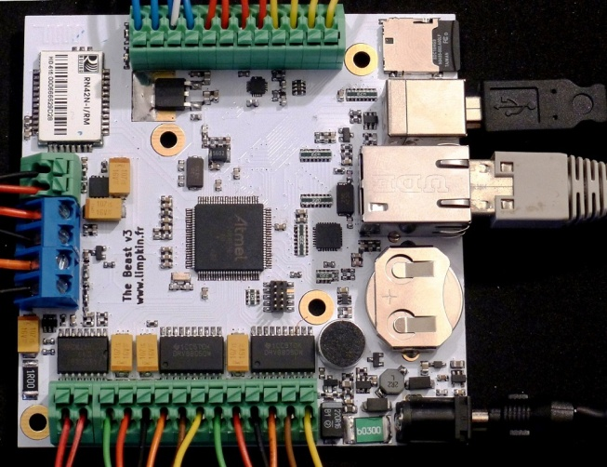
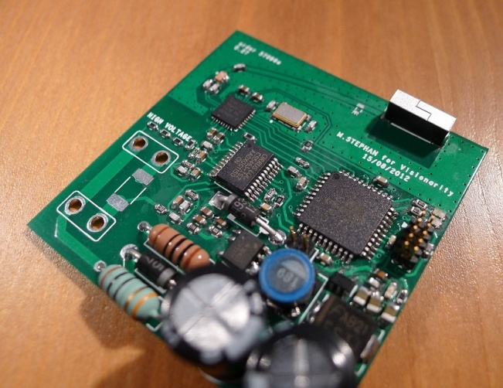
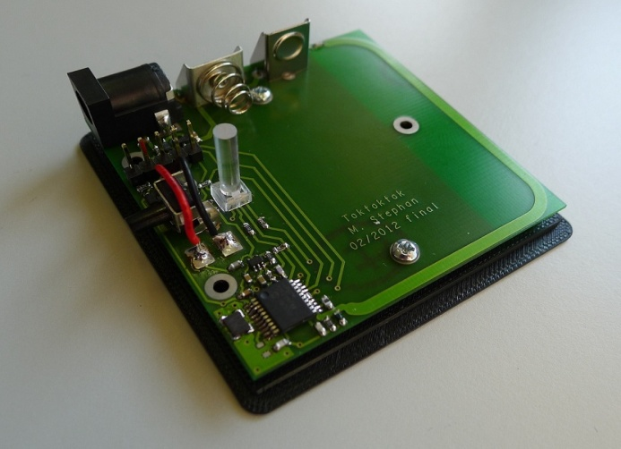
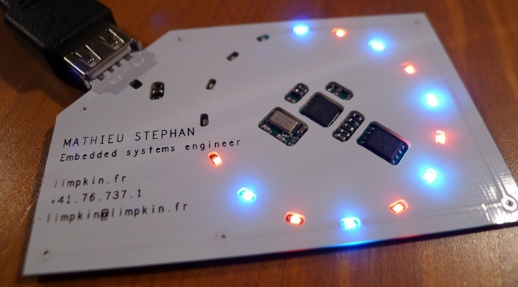
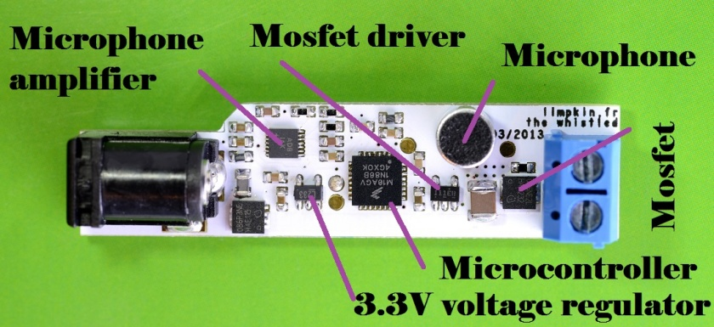
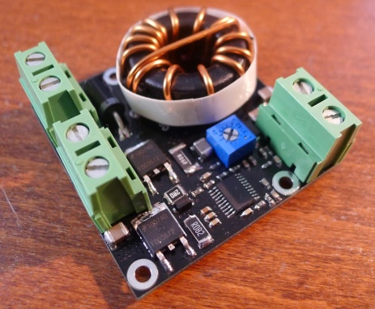
Who am I?
Creator of www.limpkin.fr

Slide 5
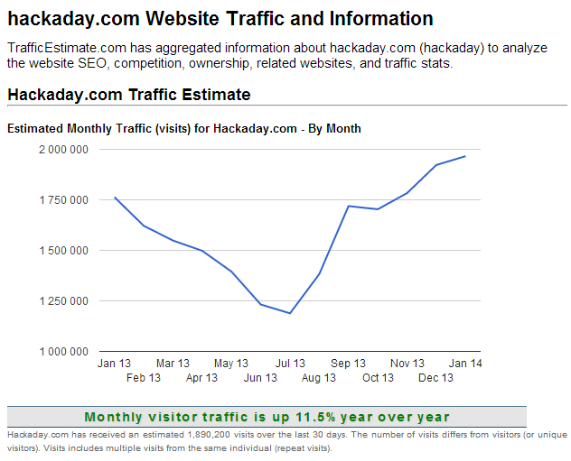
Who am I?
Daily contributor for Hackaday.com

Slide 6

Launching a new Hackaday project
Made by and for the Hackaday community
Open hardware & software
Get the readers involved in a project’s life

Slide 7
Chosen: an offline password keeper
Convenient – generate and save complex passwords
Offline – reduce the number of ways to attack the device
Simple – device is recognized as a standard HID keyboard
Secure – all stored passwords are AES-256 encrypted
(Hopefully) popular – everyone has passwords
Cheap – cost is one of the main constraints

Slide 8
Before getting into the subject…
Most security devices make compromises
We only minimize the number of ways your passwords can be compromised
Perfect security may only be achieved by making partnerships with every website on the Internet

Slide 9
How would the device work ?
ATMega32U4
OLED screen
USB HID
FLASH memory
Capacitive buttons
PIN locked smart card containing the AES-256 key

Slide 10
How would the device work ?
ebay.com credentials ?
enter pin code
checking & fetching AES key…
fetching encrypted password…
decrypting password…
typing password…
ebay.com
USB HID
(simplified)
Smart card

Slide 11
Easy attack vectors on the device
Sniffing communication buses to get the PIN code
Changing the device firmware to log the PIN / passwords
What can be done to prevent it
Have the user check that the device hasn’t been tampered with

Slide 12
Why a two components system?
Easy back-up: smart card can be cloned, encrypted passwords exported
Have multiple devices (home/work…) but only one card
Keep the smart card in a safe place

Slide 13
HID communications
The device sends key presses to the host computer
Computers sends data via HID Set_Report requests
Only website domain / service names are sent
Manually approved requests to avoid impersonation

Slide 14
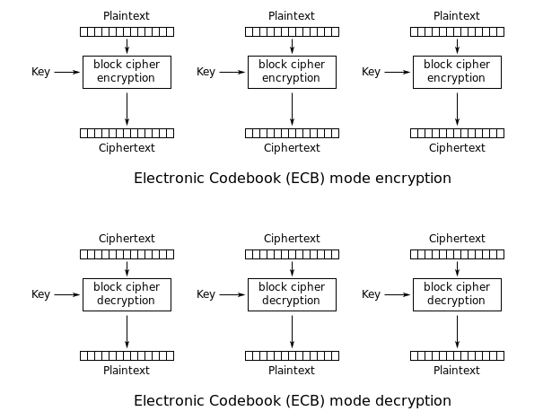
AES-256 encryption / decryption
For speed reasons, only passwords are encrypted
AVR-Cryptolib is used, AES-256 in ECB mode

Slide 15
AES-256 encryption / decryption
AES-256 checked against NESSIE* vector sets
AES-256 block size is 16bytes, max password length 32bytes
Identical plaintexts have identical ciphertexts
We therefore use [0x00 + random numbers] for padding to not leak information
“password”
0x00
random numbers
* (New European Schemes for Signatures, Integrity and Encryption)

Slide 16
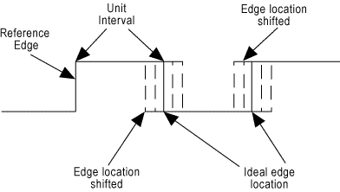
Random number generator - AVREntropy
Uses the microcontroller watchdog timer’s natural jitter to produce cryptographically secure and truly random numbers
Generates only two 32-bit numbers per second
Currently being tested (16 months)
Secure enough if the user is near the device when the random numbers are generated

Slide 17
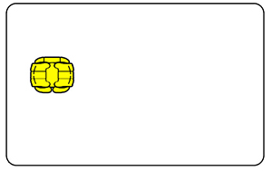
Smartcard – AT88SC102 (ATMEL)
Easily sourceable read protected memory
Locked after 4 wrong tries
16bits long PIN code
Cheap (<$1)

Slide 18
Back to Hackaday…
First article describing the concept (06/12/2013)
Several of them already had the same idea
Offered them & readers to contribute
… and the adventure started

Slide 19
An open community driven project
Show what it takes to bring an idea to the marketable stage
Offered the readers to get involved in the project
Get valuable feedback from them
For the “greater good”: all resources are available (github)

Slide 20
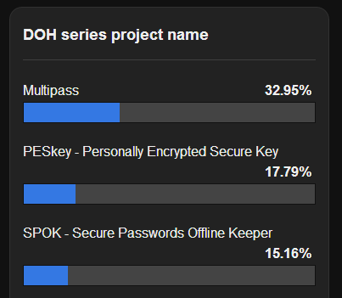
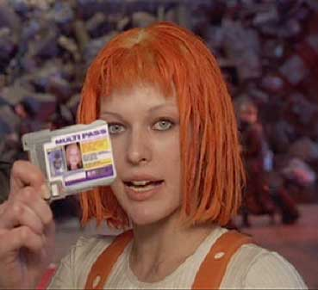
First step: project name…
Major decisions are made by directly asking the readers

Slide 21

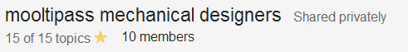
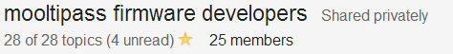
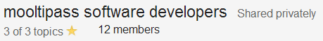
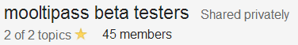
Management infrastructure
People from all over the world with different availabilities
General & development conversations : Google groups

Slide 22
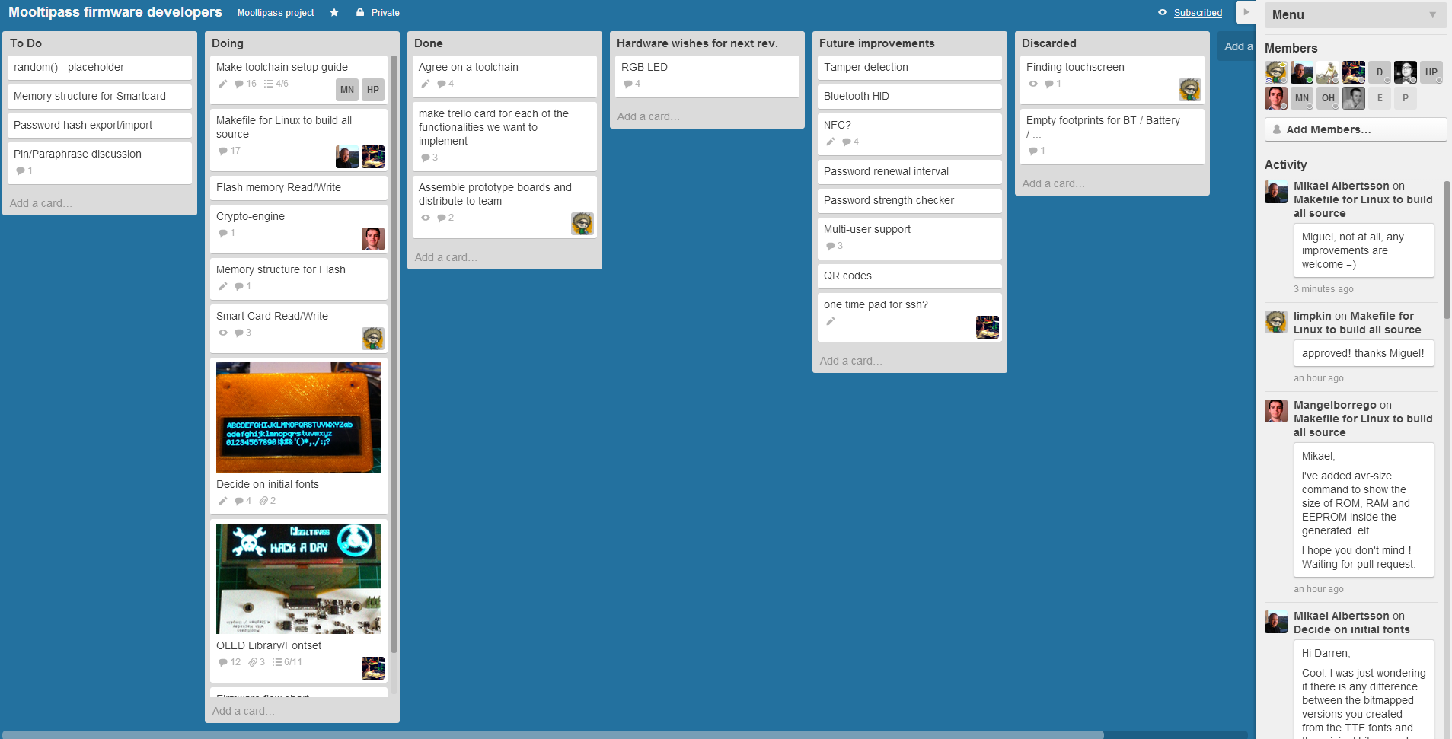
Management infrastructure
For specifics tasks, Trello boards

Slide 23
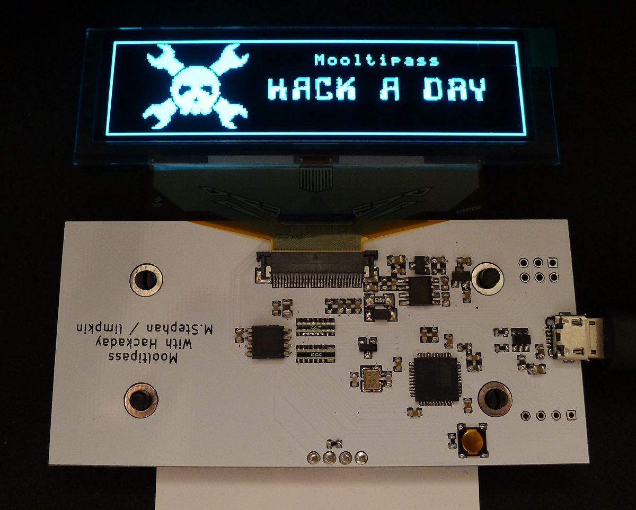
First prototype
First basic platform containing the core components

Slide 24
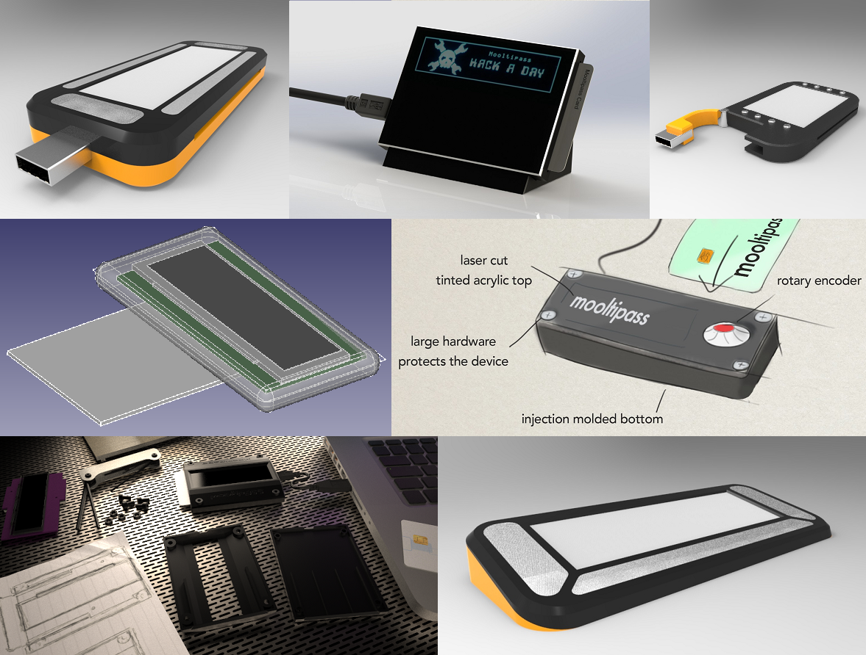
Designed cases

Slide 25
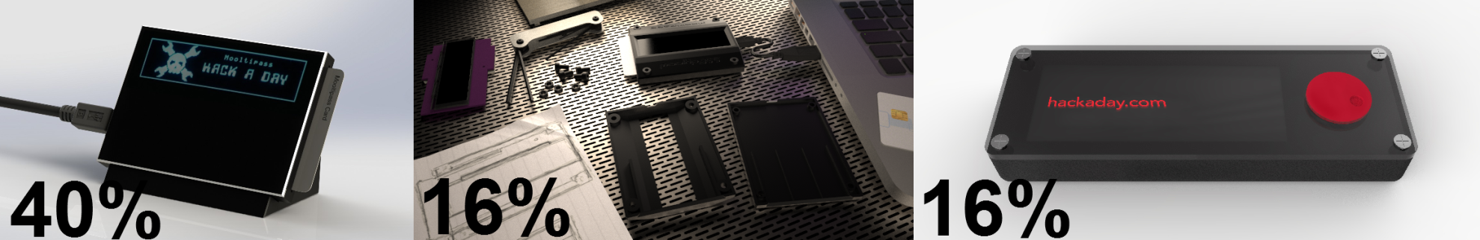
Current state
Working on integrating the electronics in the popular cases
While the firmware developers work on low level libraries
… and software developers make the browser extensions
Selected beta testers may receive prototypes in <2 months

Slide 26
Final slide
Take aways :
Creating a simple, cheap, offline password keeper
Provide a good security compromise
Open source
Questions ?
mathieu@hackaday.com

